Slide 1
A

Slide 2
B

Slide 3
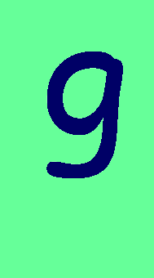
C

Slide 4
D

Slide 5
E

Slide 6
F

Slide 7
G

Slide 8
H

Slide 9
I

Slide 10
J

Slide 11
K

Slide 12
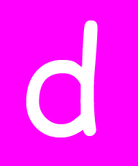
L

Slide 13
M

Slide 14
N

Slide 15
O

Slide 16
P

Slide 17
Q

Slide 18
R

Slide 19
S

Slide 20
T

Slide 21
U

Slide 22
V

Slide 23
dou

Slide 24
-ble

Slide 25
u

Slide 26
x

Slide 27
y

Slide 28
and

Slide 29
z

Slide 30
now

Slide 31
i

Slide 32
know

Slide 33
my

Slide 34
A

Slide 35
B

Slide 36
C’s

Slide 37
next

Slide 38
time

Slide 39
won’t

Slide 40
you

Slide 41
sing

Slide 42
with

Slide 43
me?

